Slide 1
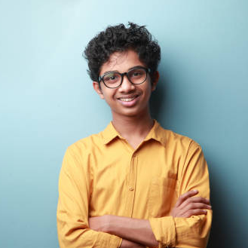
"Scientists are the architects of tomorrow, forging groundbreaking discoveries that shape the world for generations to come."
Add image that represents this persona
Goals
To be a groundbreaking scientist.
Master experiments and studies.
Enjoy chess and history books.
Frustrations
Complex explanations.
Need for more advanced challenges.
Lack of real-world examples.
Khalid Mustafa
Age:
Hometown:
Family:
11
Mumbai, India
his parents and older sister
Khalid Mustafa, 11, from Mumbai, India, is a budding scientist who dreams of changing the world. He conducts experiments, loves chess, and history books.

